Slide 1
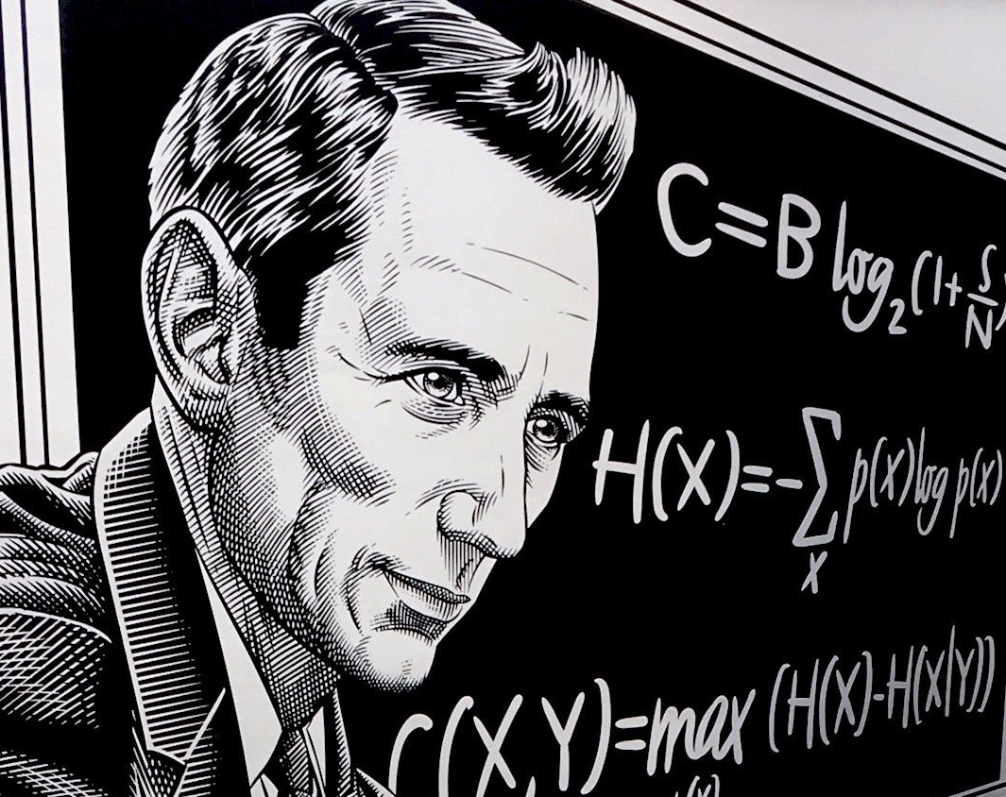
Nuggets of Shannon Information Theory
Christian Schaffner
University of Amsterdam
MCH 2022, Monday, 25 July 2022

Slide 2
Exponential Functions

Slide 3
What will you Learn from this Talk?
Logarithms
Shannon Entropy
Data Compression
Noisy-Channel Coding

